Slide 1

CS401 Modern Programming Practices (MPP) Professor Paul Corazza
MAHARISHI UNIVERSITY of MANAGEMENT
Engaging the Managing Intelligence of Nature
Computer Science Department

Slide 2
© 2015 Maharishi University of Management, Fairfield, Iowa
All rights reserved. No part of this slide presentation may be reproduced or utilized in any form or by any means, electronic or mechanical, including photocopying or recording, or by any information storage and retrieval system, without permission in writing from Maharishi University of Management.

Slide 3
Lecture 4: Interaction Diagrams
Appreciating Dynamism in Silence

Slide 4
Wholeness Statement
In an OO program, objects collaborate with other objects to achieve the objectives of the program. Sequence diagrams document the sequence of calls among objects for a particular operation. Object diagrams show relationships among objects and the associations between them; they clarify the role of multiple instances of the same class. The principle of propagation and delegation clarifies responsibilities of each class and its instances: Requests that arrive at a particular object but cannot properly be handled by the object are propagated to other objects; the task is said to be delegated to others. Finally, polymorphism makes it possible to add new functionality without modifying existing code (as per the Open-Closed Principle). In these ways, we use UML diagrams to capture the dynamic features of the system; representing dynamism in the form of a static map illustrates the principle that dynamism has its basis in, and arises within, silence.

Slide 5
Sequence Diagrams
The flow of execution

Slide 6
Our Problem Domain
A Company has a name and many Departments, each department has a name, location, and many Positions. Each position has a title and a description, and is fulfilled by a single Employee, which has an employeeId, firstname, middleInitial, lastName, birthDate, SSN, and Salary
We write a simple program to print the salary of all the employees in the company.
Recall our static class diagram for these classes.

Slide 7
Our Problem Domain

Slide 8
Our Problem Domain
Now write the code showing the attributes for the relationships between our four classes.

Slide 9
public class Company {
private String name;
private List<Department> departments;
}
public class Department {
private String name;
private String location;
private List<Position> positions;
}
public class Employee {
private String employeeId;
private String firstName;
private String middleInitial;
private String lastName;
private String SSN;
private Date birthDate;
private double salary;
}
public class Position {
private String title;
private String description;
private Employee emp;
}
Suppose we want to have multiple employees
Fill a position (e.g. senior software developer.) What code change do we make?

Slide 10
Sequence Diagram
Shows interaction between objects
Horizontal arrows indicate calls (sending messages)
Every arrow has a number, name, optional multiplicity
Vertical bars indicate method call duration
Vertical line shows lifetime of object
Is a dynamic view of a (single) Use Case
In your small groups create a sequence diagram for the use case of printing the name and salary for all the employees in the company.

Slide 11
Get Salary Sequence Diagram

Slide 12
Sequence Diagrams
A sequence diagram could show:
An object calling a method on itself
The creation of a new object
Parameters / returns
if / else and loops

Slide 13
Adding Method Calls in Code
Now add the code showing the methods we will use to print out the salaries in our four classes.
Here is the simple main class.
public class Application {
public static void main(String[] args) {
...
double totalSalary = company.getSalary();
}
}

Slide 14
Methods Calls in Code
public class Company {
private String name;
private List<Department> departments;
public double getSalary() {
double result = 0.0;
for (Department dep : departments) {
result += dep.getSalary();
}
return result;
}
}

Slide 15
public class Department {
private String name;
private String location;
private List<Position> positions;
public double getSalary() {
double result = 0.0;
for (Position p : positions) {
result += p.getSalary();
}
return result;
}
}
public class Position {
private String title;
private String description;
private Employee emp;
public double getSalary() {
return emp.getSalary();
}
}
public class Employee {
private String firstname;
private double salary;
public double getSalary() {
return salary;
}
}

Slide 16
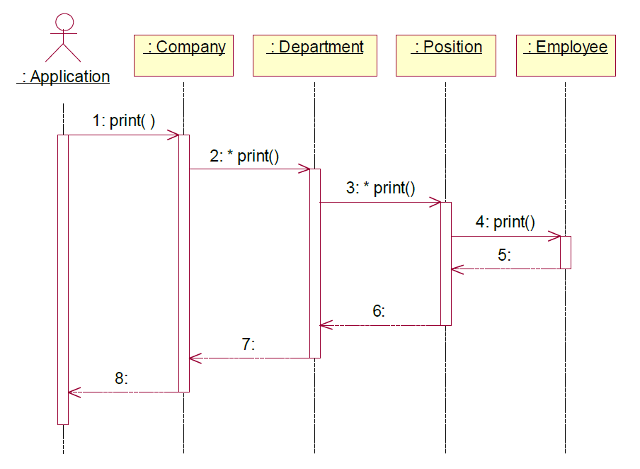
Return Arrows
Optionally you can also add arrows for returns
Not all tools support this feature

Slide 17
Midterm Practice - Reverse Engineering – Class and Sequence diagrams from code.
A Sequence Diagram can be very useful for understanding the flow for existing code.
In your group try to build a class diagram from the source code in sakai/Resources/CMTS/CM Source Code
There is a class diagram with the code. Can you spot the bug in the existing class diagram?
Now consider the use case of a cable modem registering on a CMTS. Try to build a sequence diagram for this use case. Assume the success case.

Slide 18
Main Point 1
Sequence Diagrams document the sequence of calls different objects (should) make to accomplish a specific task.
Likewise, harmony exists in diversity: Even though each object is specialized to only perform tasks related to itself, objects harmoniously collaborate to create functionality far beyond each object’s individual scope.

Slide 19
Object Diagrams
Implementation emerges from Abstraction

Slide 20
Our problem domain
A faculty member advises zero or more students, faculty members have a name and a position, students have a studentId and a name.
Student
advises
Faculty
+studentId
+name
+name
0..*
1
+position

Slide 21
Object Diagram
Underlining indicates it’s an object
Usually shows colon separated name and type
Associations don’t have multiplicities
Associations are always uni-directional
Frank : Student
Advises
Mary : Student
Advises
Michael : Faculty
Advises
John : Student

Slide 22
What is the difference?
Do these class diagrams describe the same situation?
Student
Faculty
+studentId
+name
+name
0..*
0..1
+position
Student
Faculty
+studentId
0..*
0..1
+name
+name
+position
0..*
0..1

Slide 23
Frank : Student
A symmetrical
object relationship.
Mary : Student
Michael : Faculty
John : Student
Frank : Student
Can you think of an
example of this asymmetrical
object relationship?
Mary : Student
Michael : Faculty
John : Student

Slide 24
Main Point 2
Object Diagrams show the relationships between objects, where each object is an instance of a class, and each reference is represented by a single arrow.
This phenomenon illustrates the principle that the whole is greater than the sum of the parts: The objects (parts) are not the important focus for an object diagram. What is important is how the objects relate; together, objects and their relationships form a whole that is more than just the sum of individual objects collected together.

Slide 25
Propagation & Delegation
Collaboration between objects

Slide 26
Delegation & Propagation
A class can express functionality in its interface, but it delegates responsibility to an associated class to carry out the action.
The responsibility for the action can propagate through a hierarchy to each object.

Slide 27
Anti-Pattern – Non OO Design
public void print() {
System.out.println("Company: " + name);
for (Department d : departments) {
System.out.println("Department: " + d.getName());
for (Position p : d.getPositions()) {
System.out.println("Position: " + p.getName());
for (Employee e : p.getEmployees()) {
System.out.println("Employee: " + e.getName());
}
}
}
}

Slide 28
Main Point 3
OO Systems use delegation and propagation.
An individual object only works with its own properties, acts only on what it knows, and then asks related objects to do what they know.
When individual actions are on the basis of self-referral dynamics, individual actions are automatically in harmony with each other because all arise from the dynamics of the a single unified field.

Slide 29
Polymorphism
The Open-closed Principle
Separating the change from non-change

Slide 30
Polymorphism
Polymorphism = many forms
Objects of a particular type can take different forms
Achieved through dynamic binding (late binding)
Implies that a type has subtypes (extends, implements)
Account act = new CheckingAccount();
act.toString();
CheckingAccount
Account
The method call first checks the class of the actual object to find a toString() method if not found, it checks the super
Class, up and up until Object
Object Class

Slide 31
Binding
Binding is the connection of a method call to a method implementation.
Static methods have early binding
the linkage is made at compile-time.
Private methods also have early binding (why?)
Late binding, or dynamic binding, occurs at run-time.
The JVM method-call mechanism finds the correct method body and invokes it at run-time.
by traversing the inheritance chain, starting at the actual class of the object
Late binding is what makes polymorphism work
Notes:
Private methods have early binding because they are implicitly final, they can never be overwritten, no polymorphism!

Slide 32
Up-Casting
An object of type A, can be bound to an object of type B or C
public class Student { ... }
public class Undergraduate extends Student { ... }
public class Graduate extends Student { ... }
Student st1, st2, st3;
Graduate st4;
st1 = new Student();
st2 = new Undergraduate();
st3 = new Graduate();
st4 = new Student();
Where is the Compiler Error?

Slide 33
Polymorphism example

Slide 34
public abstract class Account {
private double current_amount;
private String accountnr;
public void deposit(double amount) {
current_amount += amount;
}
public void withdraw(double amount) {
current_amount -= amount;
}
public void setAccountnr(String anr) {
accountnr = anr;
}
public String getAccountnr() {
return accountnr;
}
public double getAmount() {
return current_amount;
}
public abstract void addInterest();
}
public class CheckingAccount extends Account {
private double interest_rate = 0.01;
@Override
public void addInterest() {
deposit(getAmount() * interest_rate / 2);
}
}
public class SavingsAccount extends Account {
private double interest_rate = 0.0425;
@Override
public void addInterest() {
deposit(getAmount() * interest_rate);
}
}

Slide 35
public class Bank {
private Map<String, Account> accounts =
new HashMap<String, Account>();
public void addInterest_all_accounts() {
for (Account a : accounts.values()) {
a.addInterest();
}
}
public void addAccount(String type, String accountnr) {
Account account;
if (type.equals("checking")) {
account = new CheckingAccount();
} else {
account = new SavingsAccount();
}
account.setAccountnr(accountnr);
accounts.put(accountnr, account);
}
public void delAccount(String accountnr){
accounts.remove(accountnr);
}
}
P2I
Polymorphism

Slide 36
public class BankApp {
public static void main(String[] args) {
Bank mybank = new Bank();
mybank.addAccount("checking", "1");
mybank.addAccount("checking", "2");
mybank.addAccount("savings", "3");
mybank.addInterest_all_accounts();
}
}

Slide 37
Main Point 4
With polymorphism, objects of a particular type can take many different forms, giving us great power and flexibility.
The Unified Field is the source of all different forms in the universe.
The unmanifest can manifest in many different forms.

Slide 38
Why do we want polymorphism?
It allows us to extend our program with new features without changing existing (already tested)code.

Slide 39
Open-Closed Principle
Software should be designed so that it is open for extension, but closed for modification.
All systems change during their life cycle, but when a single change results in a cascade of changes, the program becomes fragile and unpredictable. When requirements change, you implement these changes by adding new code, not by changing old code that already works.
See bank example: new accounts (credit card account, business account) can be added without changing the other classes.
Software modules can never be 100% closed for modification. Programmer has to decide what aspects should be closed.

Slide 40
Main Point 5
Polymorphism supports use of the Open-Closed Principle: The part of our code that is established and tested is closed to modification (change), but at the same time the system remains open to changes, in the form of extensions.
In a similar way, progress in life is vitally important, and progress requires continual change and adaptation. But change stops being progressive if it undermines the integrity of life. Adaptability must be on the ground of stability.

Slide 41
Summary
Today we looked at modeling Object Collaboration and the uses of Polymorphism.
Sequence diagrams document the sequence of method calls between objects
Object diagrams show the relationships between objects. It is important to know how a class diagram translates into an Object Diagram
The OO tools of association, delegation, propagation, and polymorphism allow us to build software solutions that reflect accurately the system we are modeling and are efficient, flexible and extensible.

Slide 42
Connecting the Parts of Knowledge With the Wholeness of Knowledge
Sequence Diagrams and Object Diagrams both show how objects relate to each other.
To preserve encapsulation, objects should only act on their own properties, and to accomplish tasks that are the responsibility of other objects, they should send messages (delegation)
Transcendental Consciousness by its very nature, has the fundamental association of self-referral – the Self being aware of the Self
Wholeness moving within itself: In Unity Consciousness one feels intimately associated with all other things in creation as a result of perceiving all things in terms of one’s Self

